Slide 1
Performance Analysis of Queries in RDBMS vs NoSQL
-By Sirish Shetty B & Akshay KC
A4 Batch Bhumi Panchal
2021006

Slide 2
INTRODUCTION
Nowadays a lot of data is required to be stored and used, due to which an extra effort is needed to handle the information so that it is not lost in any way.
The programmer has to decide the best way to store and retrieve the data required for such applications. In order to decide the best way, factors like scalability and performance are to be considered while choosing the database.
In this paper, a comparison is made between structured Oracle and an unstructured MongoDB.
The result obtained is then used to realize better performance of the structured or unstructured methods.

Slide 3
Project analysis slide 2
1.
Relational & Non- Relational
Database
2.
MySQL vs MongoDB
CONTENTS
3.
Literature Survey
4.
Result & Analysis
5.
Conclusion

Slide 4

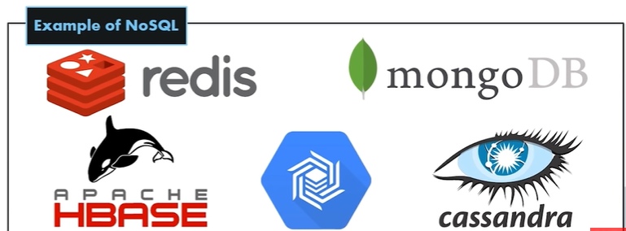
RELATIONAL DATABASE : A relational database is a collection of data items with pre-defined relationships between them. These items are organized as a set of tables with columns and rows. Tables are used to hold information about the objects to be represented in the database
Pre-defined schema
Table based databases
Good for complex queries
Vertically scalable
Has a specific language
NON–RELATIONAL DATABASE : (often called NoSQL databases) They are different from traditional relational databases in that they store their data in a non-tabular form. Instead, non-relational databases might be based on data structures like documents.
Dynamic schema
There are four different types of NoSQL databases :
Document-oriented databases, Key-Value Stores, Wide-Column
Stores, Graph Stores
Not a good fit for complex queries
No specific language
Horizontally scalable

Slide 5
MySQL
MongoDB
MySQL is a popular open-source relational database management system (RDBMS) that is developed, distributed and supported by Oracle Corporation
In MySQL, each individual records are stored as ‘rows’ in a table.
A ‘table’ is used to store rows (records) of similar type.
MySQL as the name suggests uses Structured Query Language (SQL) for database access. The schema can not be changed.
MongoDB is an open-source database developed by MongoDB, Inc. MongoDB stores data in JSON-like documents that can vary in structure. It is a popular NoSQL database.
In MongoDB, each individual records are stored as ‘documents’.
Documents belonging to a particular class or group as stored in a ‘collection’. Example: collection of users.
MongoDB is called a NoSQL database. This means that pre-defined structure for the incoming data can be defined and adhered to but also, if required different documents in a collection can have different structures. It has a dynamic schema.

Slide 6
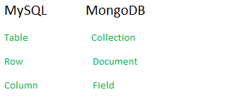

Differences in Terminology There are differences based on terminology between MongoDB
and MySQL.
Data Representation The difference between the way data is represented and stored in both the databases is quite different. MongoDB stores data in form of JSON-like documents and MySQL stores data in form of rows of table
Example : To show how data is stored and represented in MongoDB and MySQL.

Slide 7
STRUCTURE OF THE PAPER
For the purpose of illustration, we take the example of storing a record of company employee details.
To foreground the advantages and benefits of the nonrelational database MongoDB, it is compared with relational database Oracle. Basic four operations were performed on both databases :
Insert
Delete
Select (Query)
Update
On both Databases i.e MySQL and MongoDB, data insertion started with the initial 10 records and then the performance comparison was performed. Then the table records were increased to 100, 1000 and 10,000 respectively
All the study conducted in this paper is performed in a controlled environment with specific system specifications with Windows 10 64bit OS, Processor Intel Core i5, RAM 4GB.

Slide 8
Project analysis slide 3
LITERATURE SURVEY
1.
2.
3.
4.
The analysis construes the time taken by the two databases for joins, insertions and retrievals. They claim to have showed how MySQL performs better for simple queries with smaller datasets while MongoDB works better for efficient complex queries with large data sets.
They have performed the analysis for insert and search operations upto a 25000 records. They claimed that relational databases suffer from horizontal scaling whereas NoSQL performs better than MySQL.
They claimed that when the data is large the load balancing becomes difficult in SQL databases whereas MongoDB has an inbuilt load balancer which takes care the load balancing in case of large amount of data.
They have performed a comparative study of MySQL with MongoDB and claimed that MongoDB works better. They have compared the insertion, updation and querying operations in both MySQL and MongoDB.
Literature survey performed prior to the analysis.

Slide 9
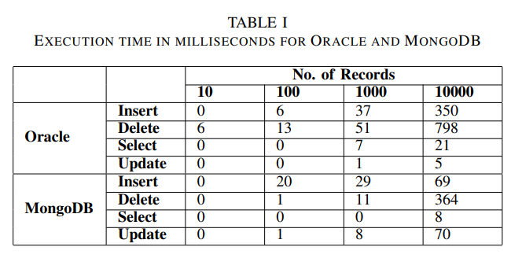
Project analysis slide 4
RESULTS & ANALYSIS
Tasks
Management Objectives
Project Objectives
Schedules
The main objective here is to compare and analyze which database performs better for the identified operations.
For each operation performed in relational and nonrelational databases hypothesis testing was performed. Procedure adopted to perform the hypothesis testing is ANOVA for all the operations.
Custom Objectives
Resources

Slide 10
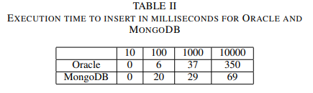
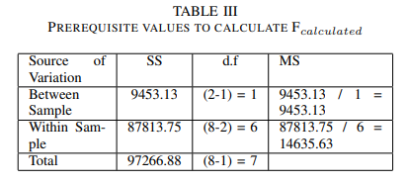
Hypothesis Testing
For Inserting :
Following hypothesis was stated :
H0 : Performance of Oracle for inserting is not better than the performance of MongoDB.
H1 : Performance of Oracle for inserting is better than the performance of MongoDB.
Based on the prerequisite value F-Ratio is calculated as
F − Ratio = MSbetween
MSwithin
= 9453.13 / 14635.63
= 0.65
Hence, the Fcalculated is 0.65.
Ftabulated is 5.99 i.e Fcalculated < Ftabulated.
Therefore the H0 is accepted which means the performance of Oracle is not better than MongoDB for inserting.

Slide 11
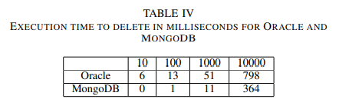
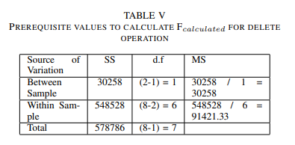
Hypothesis Testing
For Deleting :
Following hypothesis was stated :
H0 : Performance of Oracle for deleting is not better than
the performance of MongoDB.
H1 : Performance of Oracle for deleting is better than the performance of MongoDB.
Based on the prerequisite value F-Ratio is calculated as
F − Ratio = MSbetween
MSwithin
= 30258 / 91421.33
= 0.33
Hence, the Fcalculated is 0.33.
Ftabulated is 5.99 i.e Fcalculated < Ftabulated.
Therefore the H0 is accepted which means the
performance of Oracle is not better than MongoDB for
deleting.

Slide 12
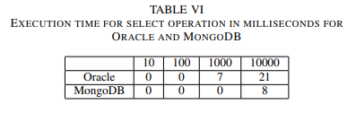
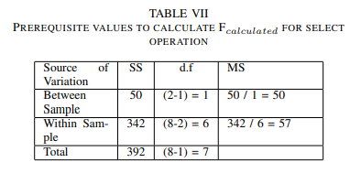
Hypothesis Testing
For Selecting :
Following hypothesis was stated :
H0 : Performance of Oracle for select operation is not better than the performance of MongoDB.
H1 : Performance of Oracle for select operation is better than the performance of MongoDB.
Based on the prerequisite value F-Ratio is calculated as
F − Ratio = MSbetween
MSwithin
= 50 / 57
= 0.88
Hence, the Fcalculated is 0.88.
Ftabulated is 5.99 i.e Fcalculated < Ftabulated.
Therefore the H0 is accepted which means the
performance of Oracle is not better than MongoDB for
select operation.

Slide 13
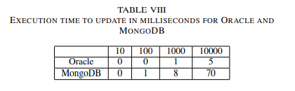
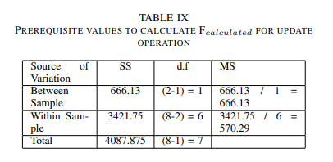
Hypothesis Testing
For Updating :
Following hypothesis was stated :
H0 : Performance of MongoDB for updating is not better than the performance of Oracle.
H1 : Performance of MongoDB for updating is better than the performance of Oracle.
Based on the prerequisite value F-Ratio is calculated as
F − Ratio = MSbetween
MSwithin
= 666.13 570.29
= 1.12
Hence, the Fcalculated is 1.12
Ftabulated is 5.99 i.e Fcalculated < Ftabulated.
Therefore the H0 is accepted which means the
performance of MongoDB is not better than Oracle for updating.

Slide 14
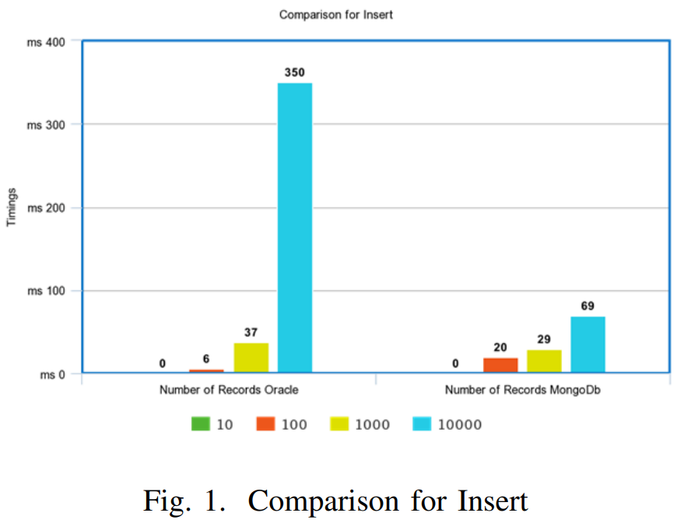
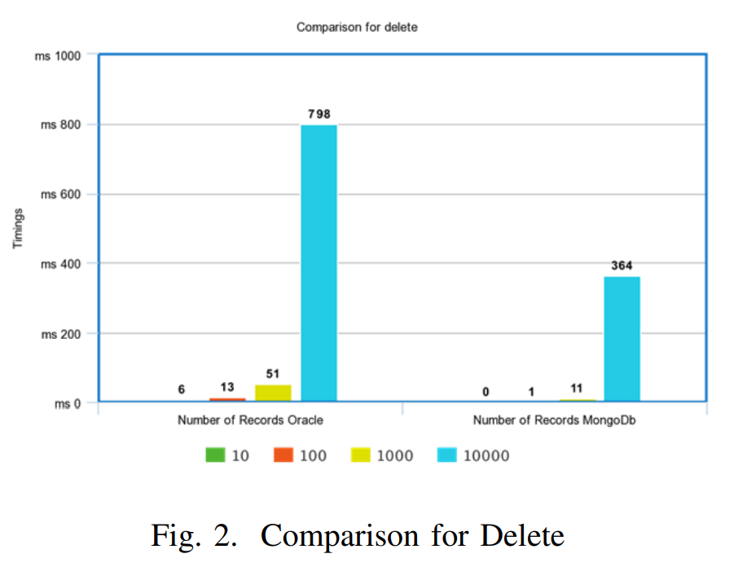

Slide 15
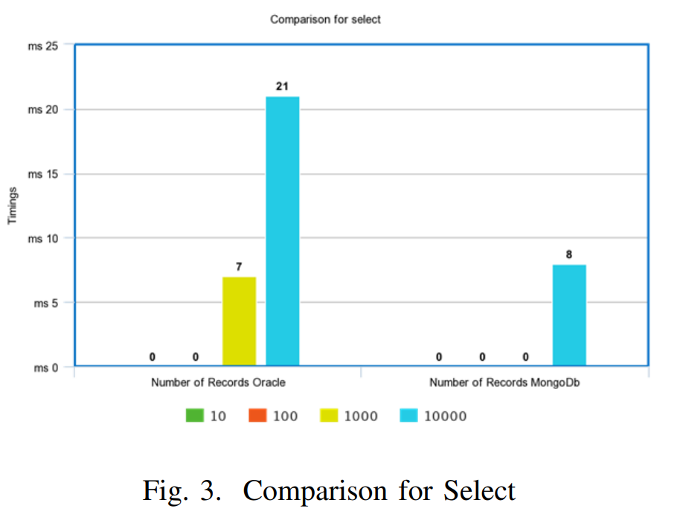
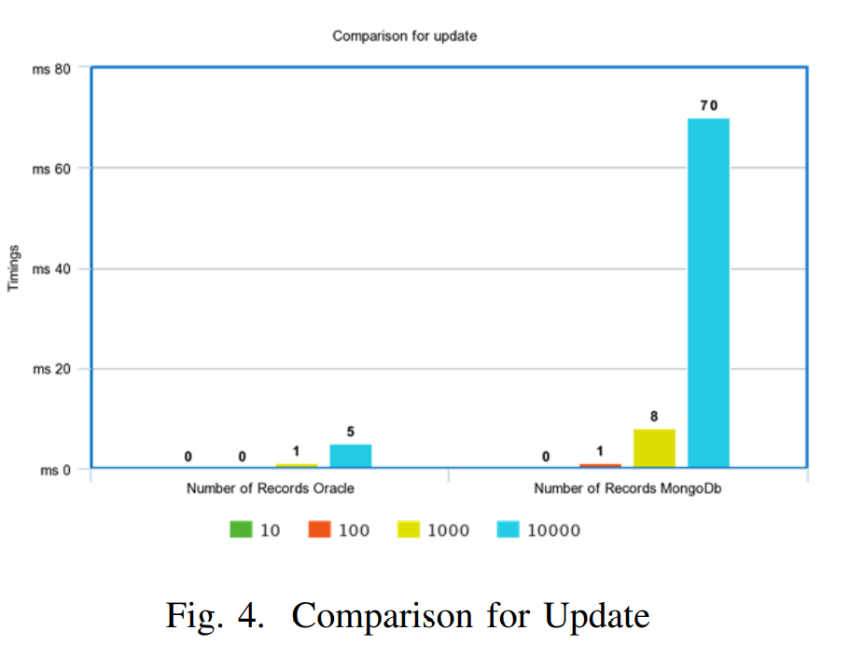

Slide 16
A comparison study has been made in this paper to realize that the non relational databases perform better than the relational databases.
Considering the data set which was taken for the experiment, it can be verified from the hypothesis testing that, MongoDb performs better only for insert, delete and select operation, whereas for update operation Oracle still performs better in the given environment.
CONCLUSION

Slide 17
Bibliography
http://ieeexplore.ieee.org.library.somaiya.edu/document/8993394
What Is MongoDB? | MongoDB
Database scalability: the future (and almost present) challenge for developers (nexusintegra.io)
https://opentextbc.ca/introbusinessstatopenstax/chapter/the-f-distribution-and-the-f-ratio/
https://www.izenda.com/relational-vs-non-relational-databases/#:~:text=To%20summarize%20the%20difference%20between,type%20of%20data%20it's%20storing
https://www.mongodb.com/compare/mongodb-mysql

Slide 18
IMPLEMENTATION STRATEGY
Creating a database
MySQL
MongoDB
Perform all the queries on both the databases
Hypothesis Testing(ANOVA Test)
Performance analysis

Slide 19
Thank You !

